Slide 1

DATS 6102 Group Project: Lydia Teinfalt, Joe Valle, Natasha Vij
Fall 2020

Slide 2
Table of Contents
Couchbase Background
Key Concepts
Comparing Couchbase with Other Databases
Live Demo

Slide 3
BACKGROUND

Slide 4
What is Couchbase?
Open-source, distributed multi-model NoSQL document-oriented database
Developed by Couchbase, Inc. Headquartered in Santa Clara, CA
Created in 2009 from the merger of CouchOne and Membase
Compared to MongoDB – created in 2007
Written in C++, Erlang, C, Go
NoSQL database technology
Sources - https://www.linkedin.com/company/couchbase/ - https://en.wikipedia.org/wiki/Couchbase_Server - https://www.couchbase.com/about

Slide 5
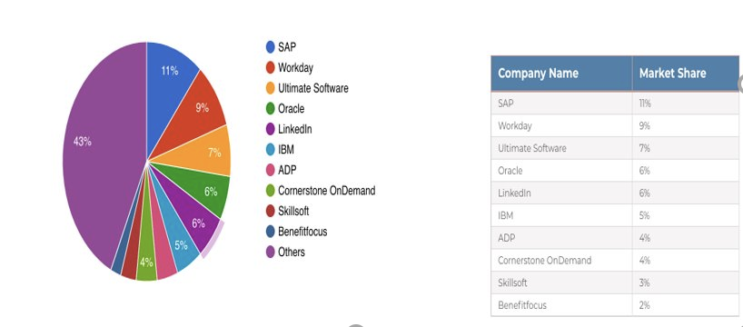
Customers
Source: - https://www.infoclutch.com/installed-base/hrms/couchbase/#counts-by-revenue - https://www.couchbase.com/customers

Slide 6
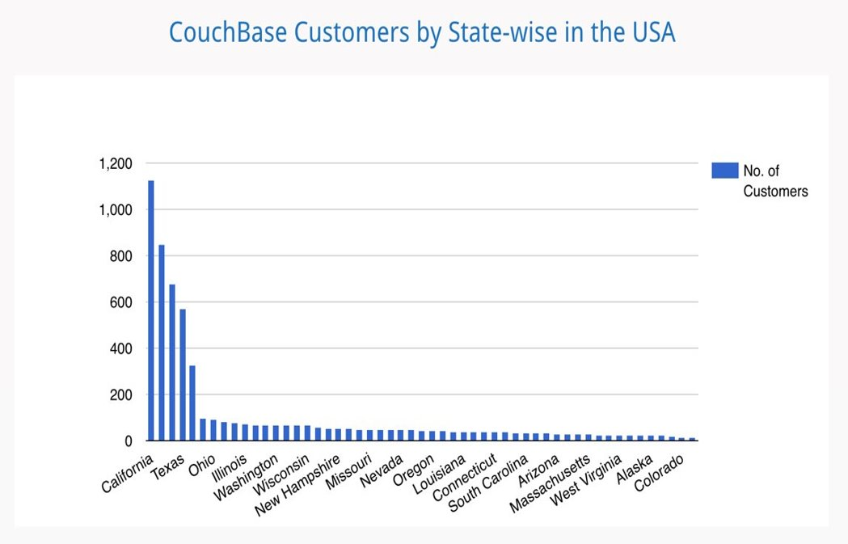
State-Wide Distribution
Source: - https://www.infoclutch.com/installed-base/hrms/couchbase/#counts-by-revenue

Slide 7
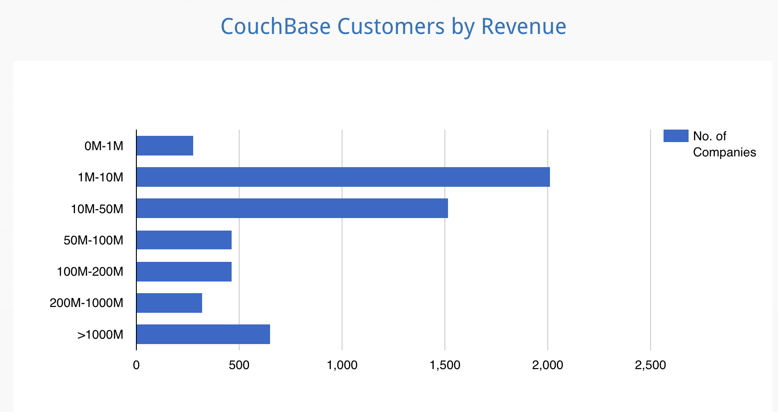
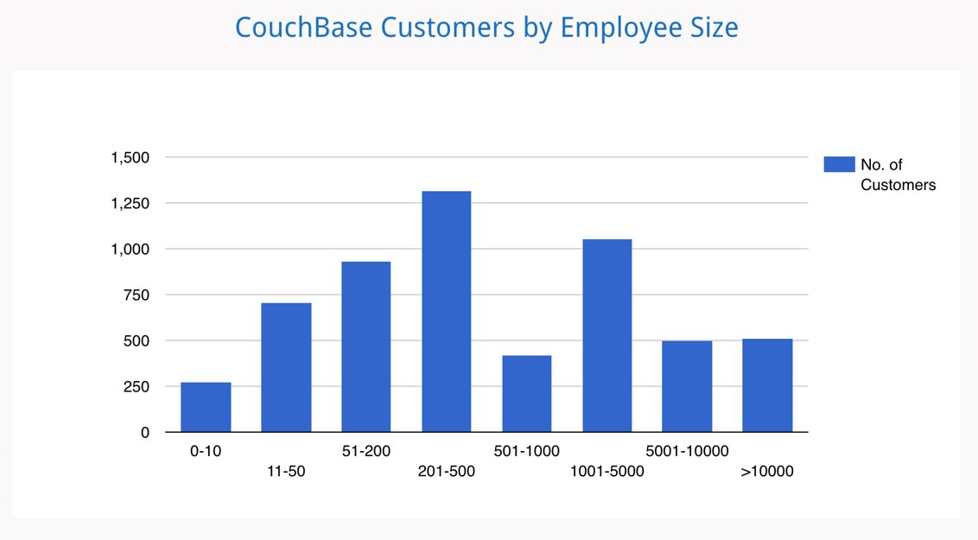
Customers by Revenue and Company Size
Source: - https://www.infoclutch.com/installed-base/hrms/couchbase/#counts-by-revenue

Slide 8



Use Case and Solutions
Aggregate data collected from different sources
Publish new product and inventory content in real time
Ensure that data is available online and offline.
Manage, support, and drive real-time data insights
Source:
- https://www.couchbase.com/solutions
- https://www.couchbase.com/customers

Slide 9
Couchbase Server
Community Version
Enterprise Version
The open-source foundation of NoSQL data platform
Best suited for non-enterprise developers
Available free of charge for both development and production
Full-featured, multi-service NoSQL database
Available free of charge
Common uses
Evaluation
Development
Unlimited preproduction testing
Sources: - https://www.couchbase.com/products/cloud/faq - https://www.couchbase.com/products/server - https://www.couchbase.com/downloads

Slide 10
Couchbase Cloud
FEATURES
Powerful NoSQL database
In-house Virtual Private Cloud deployment that secures and isolates data under customers’ control
Can be powered through AWS, Microsoft Azure, and Google Cloud Platform
BENEFITS
Control data and security
Control clusters anywhere
Control costs and maintain predictability
Sources: - https://www.couchbase.com/products/cloud/faq - https://www.couchbase.com/products/cloud - https://www.couchbase.com/downloads
Notes:
Cloud based is a fully managed, automated, and secure database as a Service that simplifies database management by deploying, managing, and operating Couchbase Server across multi-clous environments
It is flexible and is highly available – it provides an option for employers that are looking to reduce operational task while taking advantage of the database
Available to download through AWS
Fully automated and managed backups
The most common Couchbase Enterprise Software tools including Query Workbench, Analytics Workbench, Document Editor; Migration tools; and Monitoring dashboards that are built into Couchbase Cloud Service

Slide 11
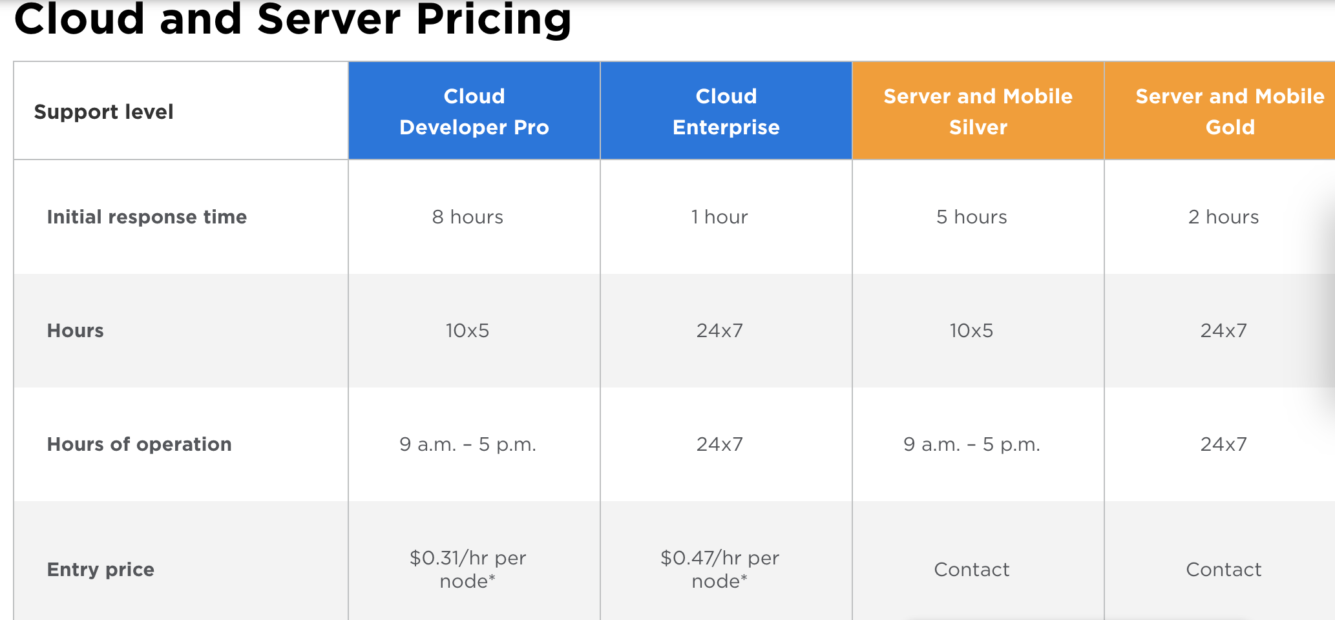
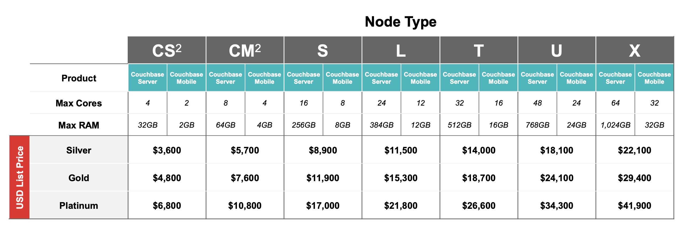
Cloud and Server Pricing
Source:
- https://www.couchbase.com/pricing
Notes:
Node - basic unit of a data structure

Slide 12
Couchbase Licensing
Need to purchase as many Enterprise Edition subscriptions as you have physical commodity servers
All Servers in cluster must be at the same subscription level
Standard duration of subscription is one year
Source: https://www.infoclutch.com/installed-base/hrms/couchbase/#counts-by-revenue
Source: - https://www.couchbase.com/licensing-and-support-faq

Slide 13

KEY CONCEPTS

Slide 14
Couchbase Key Concepts
SQL like query based on N1QL standards
Replication based on master-master model
Full text searching. This supports language-aware searching; allowing users to search for, say, the word beauties, and additionally obtain results for beauty and beautiful.
Couchbase server 6.6 has web-based UI that supports
Couchbase Web Console
Importing/exporting data
Query Workbench
Couchbase is classified as a CP server under the CAP Theorem
Consistency and partition tolerance (protection)
Data by default is eventually consistent
ACID transactions can be performed on data and are very similar to those conducted by RDBMS
Data is separated into virtual buckets that function as collections
Horizontal and vertical scaling are jointly supported
Depends on the scaling model applied when working with data
Sources:
- https://en.wikipedia.org/wiki/Couchbase_Server
- https://blog.couchbase.com/transactions-n1ql-couchbase-distributed-nosql/#:~:text=N1QL%20Transactions%20%3A%20An%20Elastic%20and%20Scalable%20Distributed,START%20TRANSACTION%3B%20UPDATE%20customer%20SET%20b%20...%20
- https://resources.couchbase.com/nosql_comparison_web

Slide 15
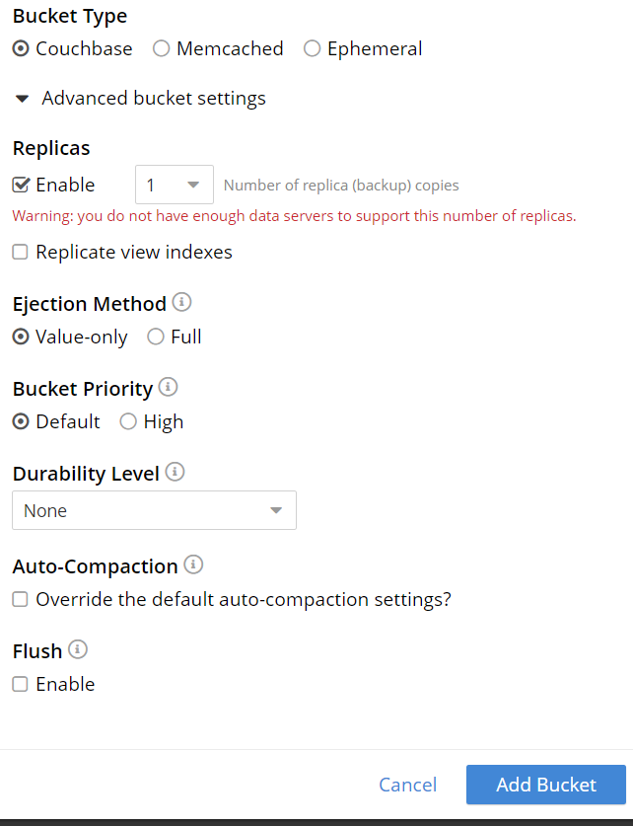
Buckets
Bucket is a collection of documents
Bucket types
Couchbase
Ephemeral
Memcached
Specify memory quota
Enable up to 3 replicas
Create index to search buckets
Import documents into bucket using JSON list, CSV
Notes:
CREATE PRIMARY INDEX def_primary ON `restaurants`;

Slide 16
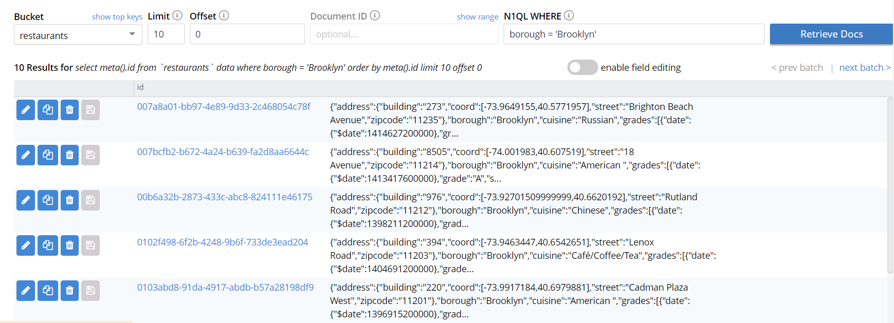
Document Editor
Document editor built into web client
Index must be created first to use "WHERE" clause
Enable field editing to provide interface to update data without using JSON
Document operations
Edit JSON format
Copy (edit new doc ID) into a new document
Delete

Slide 17
CAP Theorem and Transactions
Outline of the CAP Theorem
Consistency
Availability
Protection (partition tolerance)
Couchbase is designated as a CP server
May be set up as an AP system with multiple clusters
Provides support for replication between servers
Transaction format is very similar to RDBMS
N1QL applies SQL-like queries to JSON files under Couchbase
Couchbase supports ACID transactions
Atomicity: All or nothing (automatic rollback after any failure)
Consistency: Data is valid under all constraints
N1QL checks for any pre-existing keys and rolls back transactions that violate any constraint
Isolation: Unaffected by other transactions
Applies optimistic concurrency control (assumes that multiple transactions can be completed without interfering with one another)
Durability: Data remains the same in the system
Sources:
- http://info.couchbase.com/rs/302-GJY-034/images/MongoDB_vs_Couchbase_Architecture_WP.pdf
- https://en.wikipedia.org/wiki/Couchbase_Server
- https://blog.couchbase.com/transactions-n1ql-couchbase-distributed-nosql/#:~:text=N1QL%20Transactions%20%3A%20An%20Elastic%20and%20Scalable%20Distributed,START%20TRANSACTION%3B%20UPDATE%20customer%20SET%20b%20...%20

Slide 18
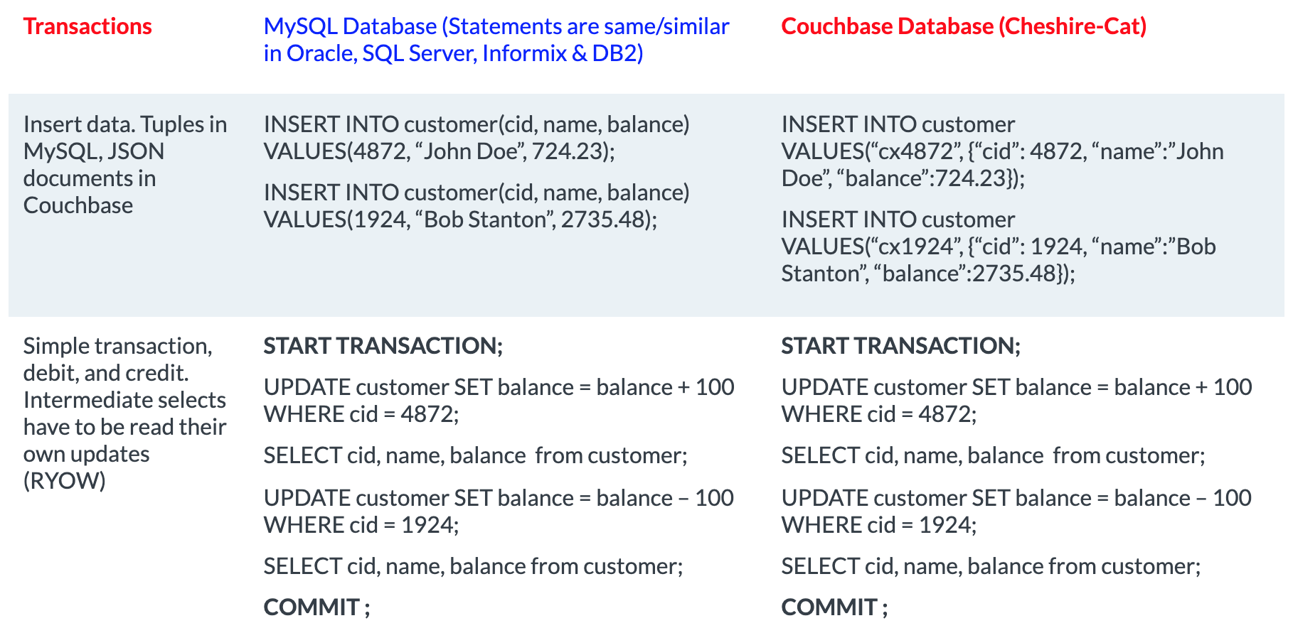
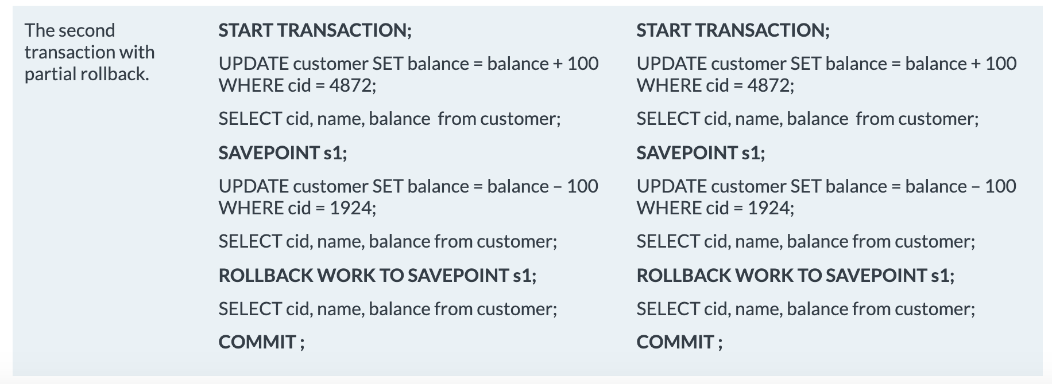
Inserting Data and Transactions
MySQL
Couchbase
MySQL
Couchbase
Source:
- https://blog.couchbase.com/transactions-n1ql-couchbase-distributed-nosql/#:~:text=N1QL%20Transactions%20%3A%20An%20Elastic%20and%20Scalable%20Distributed,START%20TRANSACTION%3B%20UPDATE%20customer%20SET%20b%20...%20

Slide 19
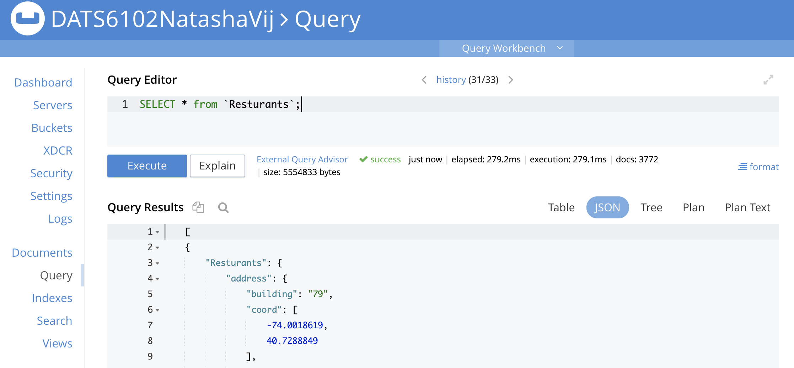
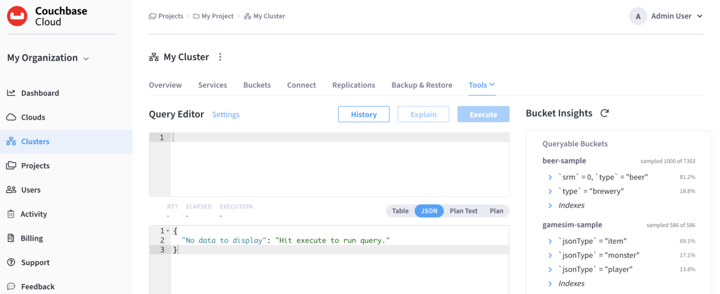
Couchbase Server vs. Cloud Query Workbench
Server-Based Query Workbench
Cloud-Based Query Work Editor
Source - https://docs.couchbase.com/cloud/clusters/query-service/query-workbench.html

Slide 20
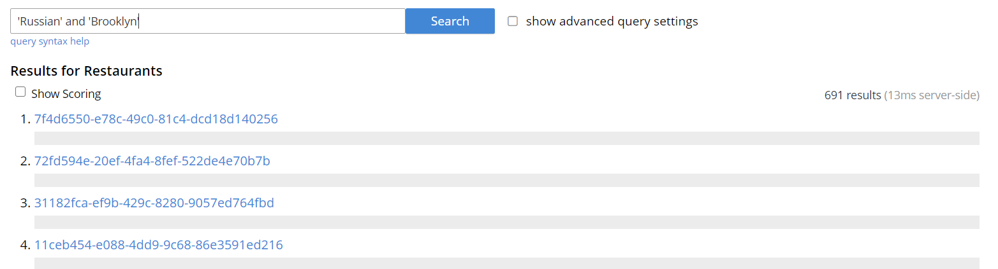
Full Text Search
Document collection must be indexed
Query language Google- like
No need to know specific field names but field scoping is available.
+borough: Brooklyn
Search items can be required, optional or excluded
You can specify numeric and date ranges with >, >=, <, and <= operators

Slide 21
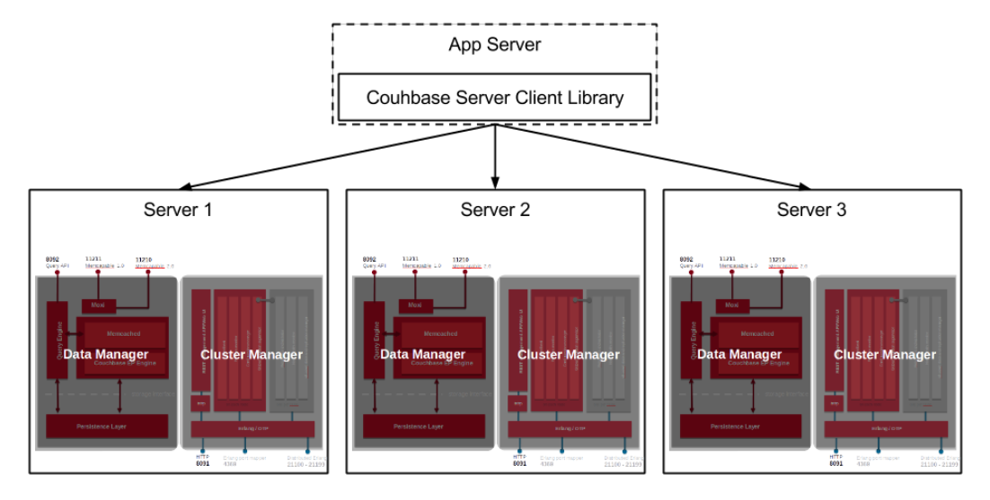
Topology and Partitioning
Couchbase has a flat topology with a single node type
All nodes are equal and communicate to each other on demand
Nodes run processes assigned with a Data Manager and Cluster Manager
Couchbase partitions data in 1,024 virtual buckets
Assigns buckets to nodes once opened
Buckets store all data within a given range
Cluster map that outlines buckets to nodes makes routers or configuration servers unnecessary
Sources:
- https://blog.couchbase.com/transactions-n1ql-couchbase-distributed-nosql/#:~:text=N1QL%20Transactions%20%3A%20An%20Elastic%20and%20Scalable%20Distributed,START%20TRANSACTION%3B%20UPDATE%20customer%20SET%20b%20...%20
- http://info.couchbase.com/rs/302-GJY-034/images/MongoDB_vs_Couchbase_Architecture_WP.pdf

Slide 22


Comparing Couchbase with Other Databases

Slide 23
Couchbase vs RDBMS
Couchbase | RDBMS
Collection stored in buckets | Tables
Key value | Rows
Query | Column
Index | Joins
Supports ACID transactions | Primary and foreign keys
No schema | Schema

Slide 24
Similarities with MongoDB
Both are document-oriented databases
Schema-less and classified under NoSQL
Under CAP Theorem consistency and partition tolerance are prioritized in both
Both may apply secondary indexes
By default both are set to be eventually consistent
Option is available to switch to immediate consistency
Both can perform maintenance using CLI
Both offer node-to-node-encryption for security purposes
Both support ACID and multi-document transactions
Both can scale horizontally
Neither are solely cloud-based systems
Foreign keys are not required in either
Sources:
- https://db-engines.com/en/system/Couchbase%3BMongoDB
- https://pediaa.com/what-is-the-difference-between-couchbase-and-mongodb/#:~:text=%20Difference%20Between%20Couchbase%20and%20MongoDB%20%201,was%20written%20in%20C%2C%20Go%2C%20JavaScript...%20More%20
- https://www.couchbase.com/nosql-database-cloud-comparison
- https://resources.couchbase.com/nosql_comparison_web
- https://blog.couchbase.com/distributed-multi-document-acid-transactions-in-couchbase/#:~:text=Couchbase%20ACID%20transactions%20are%20multi-document%20and%20multi-node%20%E2%80%93,with%202%20replicas%20%28total%203%20copies%20of%20data%29.

Slide 25
Differences from MongoDB
Couchbase writes data in multiple data files in an append-only manner
MongoDB stores data into collections using BSON
Secondary database models
Couchbase: Key-value store
MongoDB: Search engine
Scalability
Couchbase
Homogenous scaling model: Distributes a workload evenly for each node across a cluster
Multidimensional scaling model: Allows services to independently expand in order to limit competition and interference between each other
MongoDB
Master-slave replication
Horizontal data partitioning (sharding)
Sources:
- https://db-engines.com/en/system/Couchbase%3BMongoDB
- https://pediaa.com/what-is-the-difference-between-couchbase-and-mongodb/#:~:text=%20Difference%20Between%20Couchbase%20and%20MongoDB%20%201,was%20written%20in%20C%2C%20Go%2C%20JavaScript...%20More%20
- https://resources.couchbase.com/nosql_comparison_web
- https://www.couchbase.com/nosql-database-cloud-comparison

Slide 26
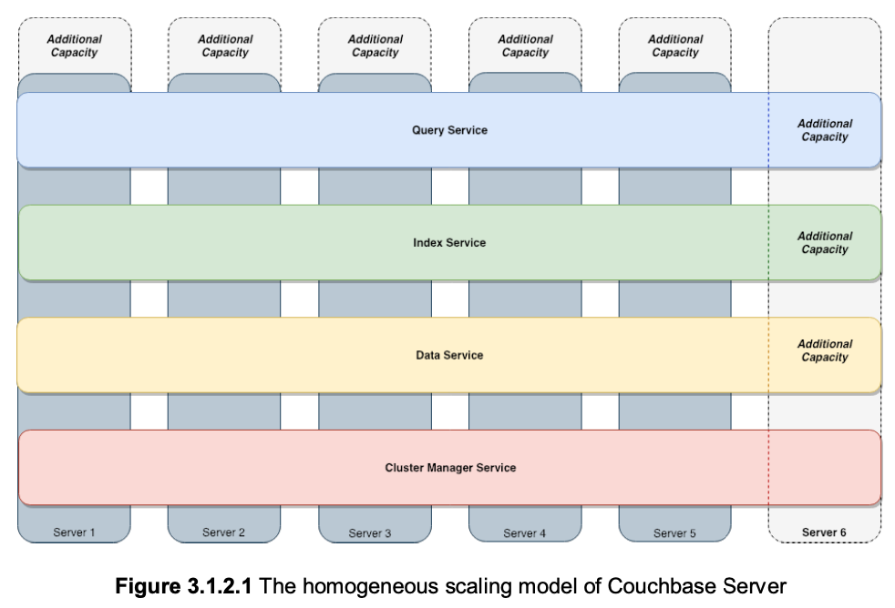
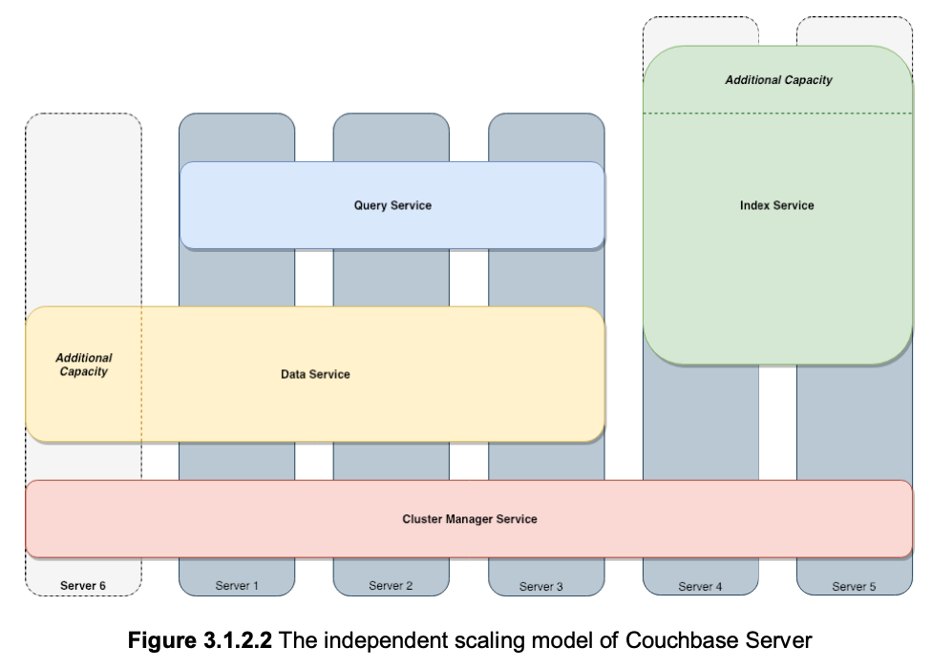
Homogenous Scaling versus Multidimensional Scaling
Source:
- https://resources.couchbase.com/nosql_comparison_web

Slide 27
Advantages
Couchbase
MongoDB
Fully integrated caching layer that doesn't require other caching products to improve performance
Multi-dimensional scaling (MDS) can be applied to isolate workloads, and can be done vertically
Extends ANSI SQL to support JSON's flexible schema
Accesses all functionality more easily without using a unique query language
Adaptive index partitioning to isolate data
Applies SQL-like querying that goes beyond read-only queries
Nodes can read and write
Does not require master-slave replication between servers
Can also perform maintenance with Web UI or REST API
Supports more programming languages
Compatible with more operating systems
Performs somewhat better with small-sized clusters and data sets
Sources:
- https://www.couchbase.com/comparing-couchbase-vs-mongodb
- https://db-engines.com/en/system/Couchbase%3BMongoDB
- https://resources.couchbase.com/nosql_comparison_web
- https://www.couchbase.com/nosql-database-cloud-comparison
- https://pediaa.com/what-is-the-difference-between-couchbase-and-mongodb/#:~:text=%20Difference%20Between%20Couchbase%20and%20MongoDB%20%201,was%20written%20in%20C%2C%20Go%2C%20JavaScript...%20More%20
- https://resources.couchbase.com/c/altoros-nosql-performance-benchmark?x=N-I_ik

Slide 28


Live Demo

Slide 29
References
https://nordicapis.com/what-is-the-difference-between-an-api-and-an-sdk/
https://www.couchbase.com/comparing-couchbase-vs-mongodb
https://db-engines.com/en/system/Couchbase%3BMongoDB
https://db-engines.com/en/system/CouchDB%3bCouchbase%3bMongoDB
https://pediaa.com/what-is-the-difference-between-couchbase-and-mongodb/#:~:text=%20Difference%20Between%20Couchbase%20and%20MongoDB%20%201,was%20written%20in%20C%2C%20Go%2C%20JavaScript...%20More%20
https://www.couchbase.com/nosql-database-cloud-comparison
https://docs.couchbase.com/server/current/n1ql/n1ql-language-reference/join.html
https://docs.couchbase.com/server/6.5/fts/query-string-queries.html
https://docs.couchbase.com/server/current/learn/services-and-indexes/indexes/indexing-and-query-perf.html
https://docs.couchbase.com/server/current/manage/manage-buckets/create-bucket.html
https://www.linkedin.com/company/couchbase/

Slide 30
References Continued
https://en.wikipedia.org/wiki/Couchbase_Server
https://resources.couchbase.com/nosql_comparison_web
https://resources.couchbase.com/c/altoros-nosql-performance-benchmark?x=N-I_ik
https://dzone.com/articles/how-acid-mongodb
https://www.infoclutch.com/installed-base/hrms/couchbase/#counts-by-revenue
https://www.couchbase.com/products/cloud
https://www.couchbase.com/downloads
https://www.couchbase.com/products/cloud/faq
https://www.couchbase.com/licensing-and-support-faq
https://blog.couchbase.com/transactions-n1ql-couchbase-distributed-nosql/#:~:text=N1QL%20Transactions%20%3A%20An%20Elastic%20and%20Scalable%20Distributed,START%20TRANSACTION%3B%20UPDATE%20customer%20SET%20b%20...%20
http://info.couchbase.com/rs/302-GJY-034/images/MongoDB_vs_Couchbase_Architecture_WP.pdf
https://www.couchbase.com/customers

